Slide 1
Effective Visualization of Radar Data for Users Impacted by Color Vision Deficiency
Zachary Sherman 1, Max Grover 1, Robert Jackson 1, Scott Collis 1, Joseph O'Brien 1, Cameron R. Homeyer 2, Randy J. Chase 3, Timothy J. Lang 4, Daniel M. Stechman 5, Alyssa Sockol 5, Kai Muehlbauer 6, Jonathan Thielen 7, Adam Theisen 1, Sam Gardner8
1. Argonne National Laboratory
2. School of Meteorology, University of Oklahoma
3. Cooperative Institute for Research in the Atmosphere (CIRA), Colorado State University
4. Earth Science Branch, NASA Marshall Space Flight Center, Huntsville, Alabama
5. Cooperative Institute for Severe and High-Impact Weather Research and Operations (CIWRO), University of Oklahoma
6. Institute of Geosciences, Meteorology Section Rheinische Friedrich-Wilhelms Universitaet Bonn
7. Colorado State University
8. Texas A&M University

Slide 2
Color Vision Deficiency
Color Vision Deficiency (CVD) is a decreased ability to discern between particular colors.
8% of genetic males and 0.5% of genetic females have some form of CVD, with many in the radar community falling into this group.
The four types of red-green CVD are deuteranomaly which makes green look more red, protanomaly which makes red look more green and less bright, and protanopia and deuteranopia which make green and red indistinguishable (Sharp et al. 1999; Neitz et al. 2011).
There are also two types of blue-yellow CVD. Tritanomaly makes it difficult to distinguish between blue and green as well as between yellow and red. Tritanopia makes the individual less able to distinguish between blue and green, purple and red, as well as yellow and pink (Sharp et al. 1999; Neitz et al. 2011).
Complete color blindness is also possible, but quite rare.

Slide 3
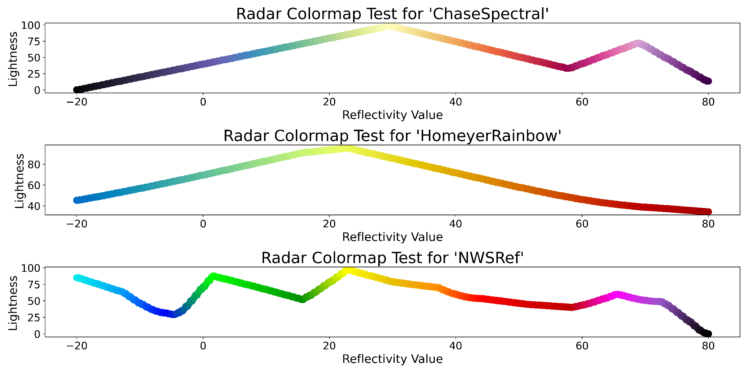
Current Radar Colormaps
Perceptual uniformity is when changes in color and data values are weighted equally and thus do not create artificial structure (Crameri et al. 2020).
Colormaps should also have perceptual order or lightness that increases linearly to avoid perception of artificial gradients and to ease comparison of significant values (Crameri et al. 2020).
The colormaps used in the radar community, such as the National Weather Service (NWS) reflectivity colormap, use uneven gradients and include green and red colors with similar lightness, which are not distinguishable for the majority of those with CVD.

Slide 4
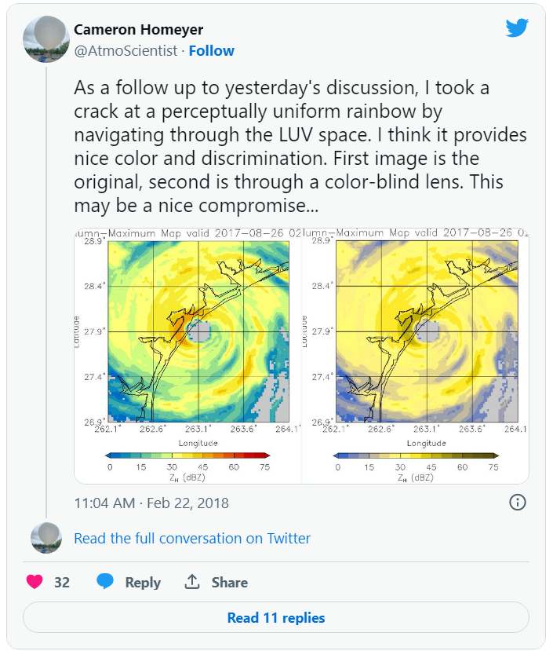
From Twitter to GitHub a Discussion on CVD-friendly Colomaps

Slide 5
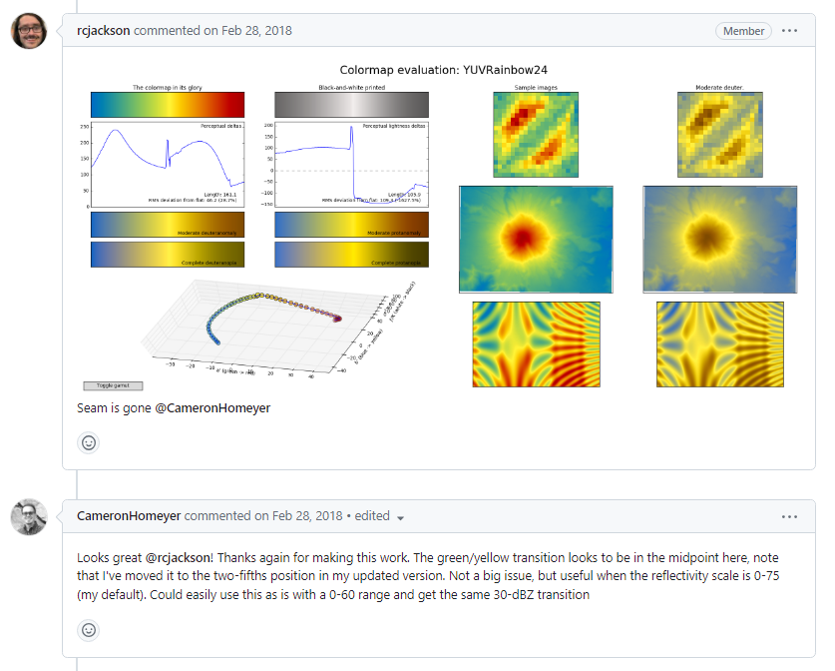
From Twitter to GitHub a Discussion on CVD-friendly Colomaps
Notes:
colorspacious and viscm

Slide 6
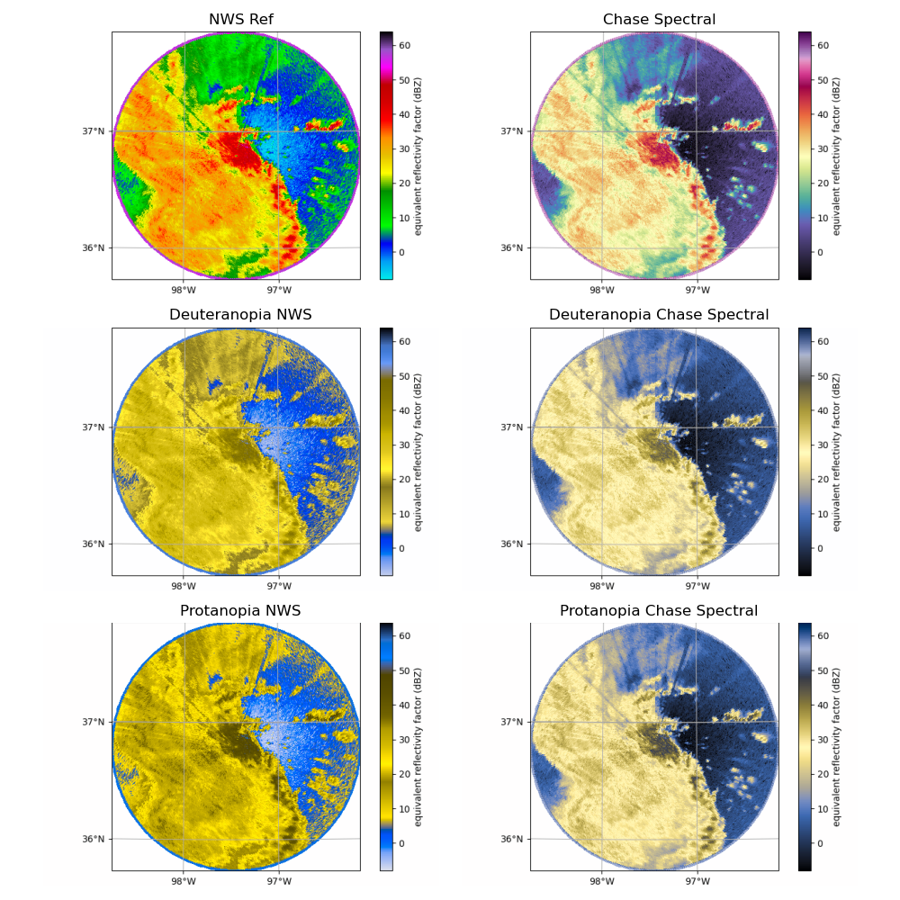
CVD-friendly Reflectivity Colormaps Comparison

Slide 7
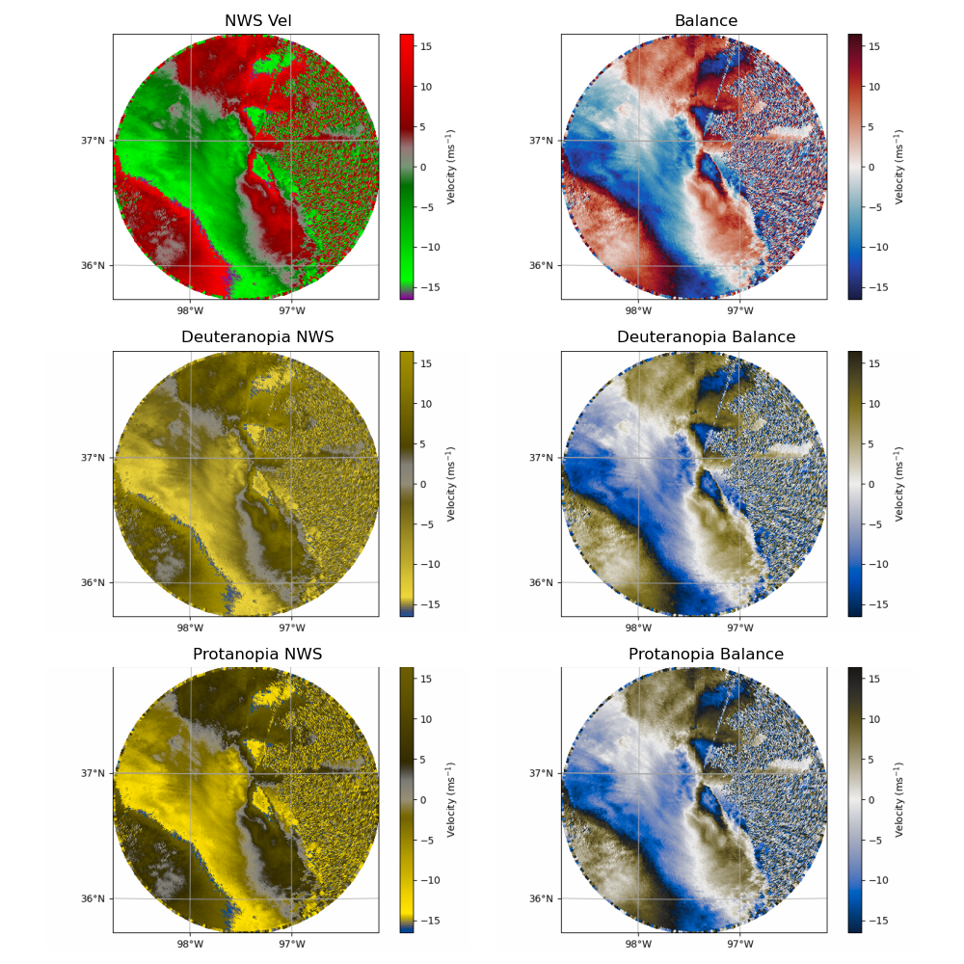
CVD-friendly Velocity Colormaps Comparison
(Thyng et al. 2016)
Notes:
highlighting the zero isodop and ensuring a good perceptual contrast across the Nyquist interval.

Slide 8
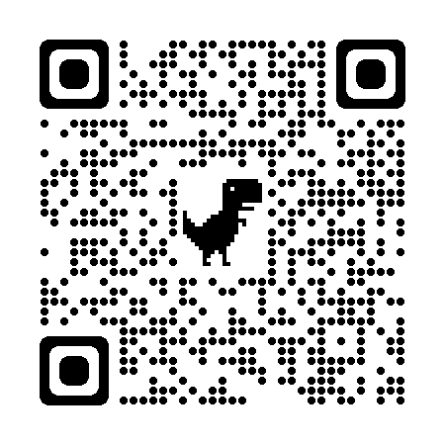
A Package for CVD-friendly Colormaps
After working with the community, multiple CVD-friendly colormaps were created.
These colormaps were originally added to Py-ART.
After some discussion, we realized the amount of individuals using the colormaps were growing and we needed a better place for these colormaps to reside.
We created a package available on GitHub called cmweather to hold these CVD-friendly colormaps as well as other colormaps used within the atmospheric community.

Slide 9
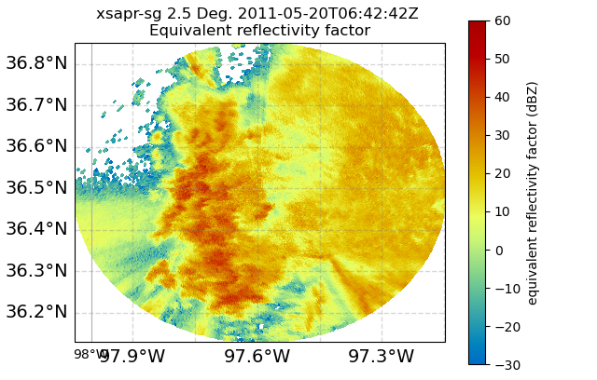
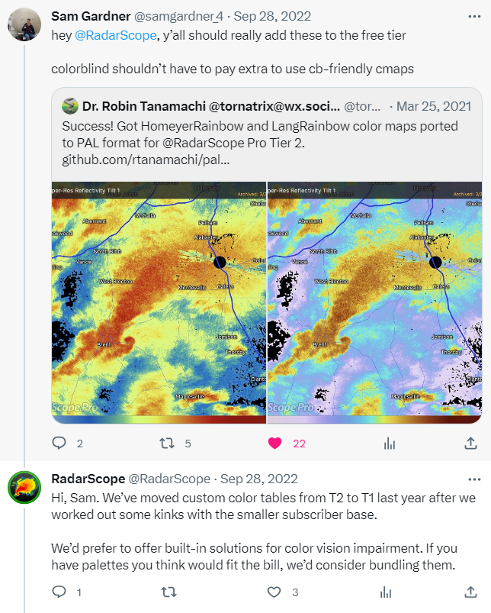
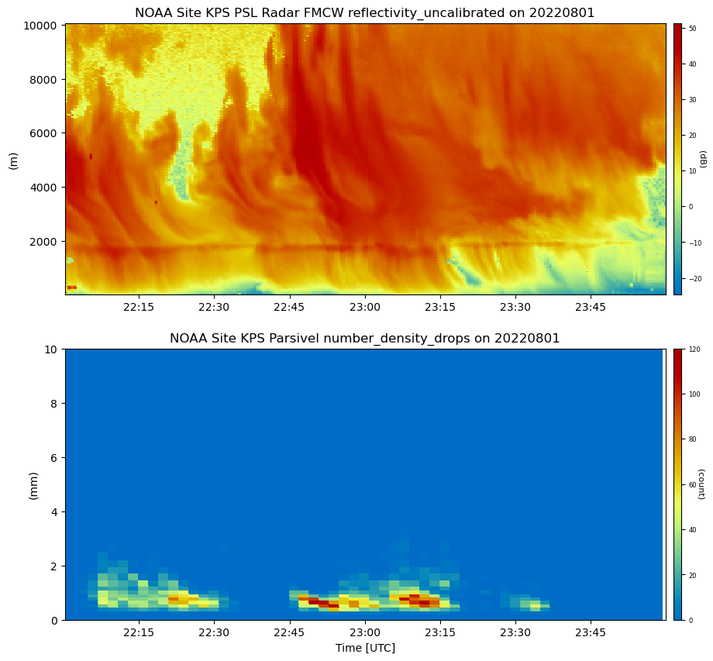
A Package for CVD-friendly Colormaps

Slide 10
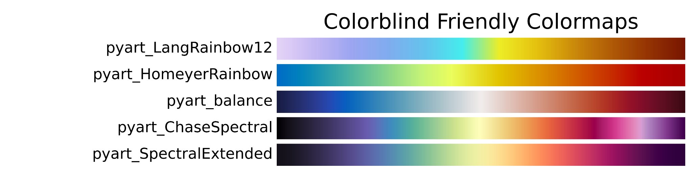
Future Plans
Additionally testing on other weather events.
Develop colormaps for other moments such as correlation coefficient etc.
Paper in progress!
Release cmweather on conda-forge and PyPI (soon)

Slide 11
Final Thoughts
Our goal was to be more inclusive and have colormaps that could be used by the CVD community, while communicating the science accurately.
We wanted these colormaps to be available for the community as a whole to use.
Legacy colormaps will be still available such as NWS Ref etc in a lot of these open source packages.

Slide 12
References
Crameri, F., G.E. Shephard and P.J. Heron, 2020: The misuse of colour in science communication. Nat Commun 11, 5444 https://doi.org/10.1038/s41467-020-19160-7
Heistermann, M., and coauthors, 2015: The Emergence of Open-Source Software for the Weather Radar Community, Bull. Amer. Meteor. Soc., 96, 117-128, https://doi.org/10.1175/BAMS-D-13-00240.1
Helmus, J.J., and S.M. Collis, 2016: The Python ARM Radar Toolkit (Py-ART), a Library for Working with Weather Radar Data in the Python Programming Language. Journal of Open Research Software. 4(1), p.e25. DOI: http://doi.org/10.5334/jors.119
Neitz, J. and M. Neitz, 2011: The genetics of normal and defective color vision. Vis. Res. 51, 633–651.
Sharpe, L. T., A. Stockman, H. Jägle, and J. Nathans, 1999: Opsin Genes, Cone Photopigments, Color Vision, and Color Blindness. Vol. 351 (Cambridge University Press, 1999).
Smith, N.J, and coauthors, 2018: njsmith/colorspacious v1.1.2 (Version v1.1.2). Zenodo. http://doi.org/10.5281/zenodo.1214904
Thyng, K. M., Greene, C. A., Hetland, R. D., Zimmerle, H. M., and DiMarco, S. F., 2016: True colors of oceanography. Oceanography, 29(3), 10.

